Slide 1
TEAM GREEN CODE

Slide 2
Table of contents
01
02
03
04
The project
Project goals
Our team
Stages

Slide 3
The project
This game is about connecting chemical elements to the corresponding positions so that they make the chemical name shown.

Slide 4
Project goals
Goal 1
Goal 2
To form and create the team and distribute the tasks evenly
Come up with the idea for the game, then we started working on the project
Finish and complete the whole project, and then test to see if everything works properly

Slide 5
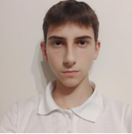
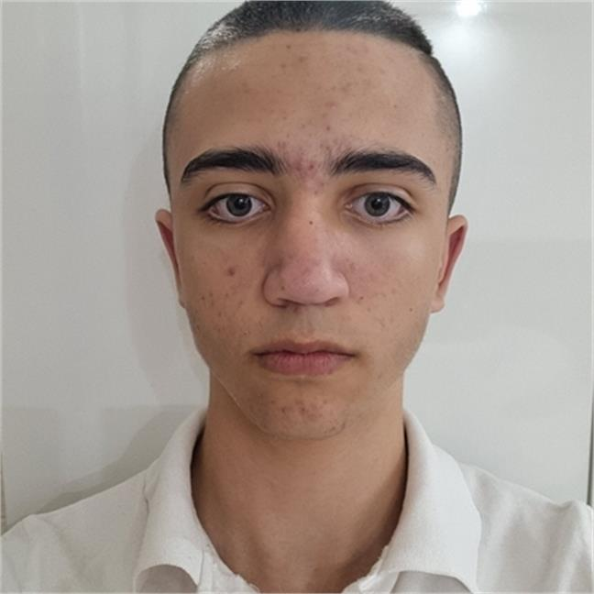
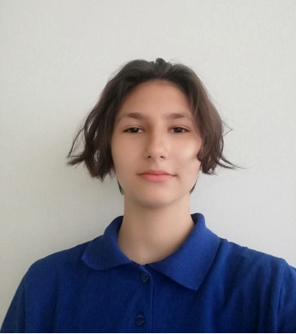
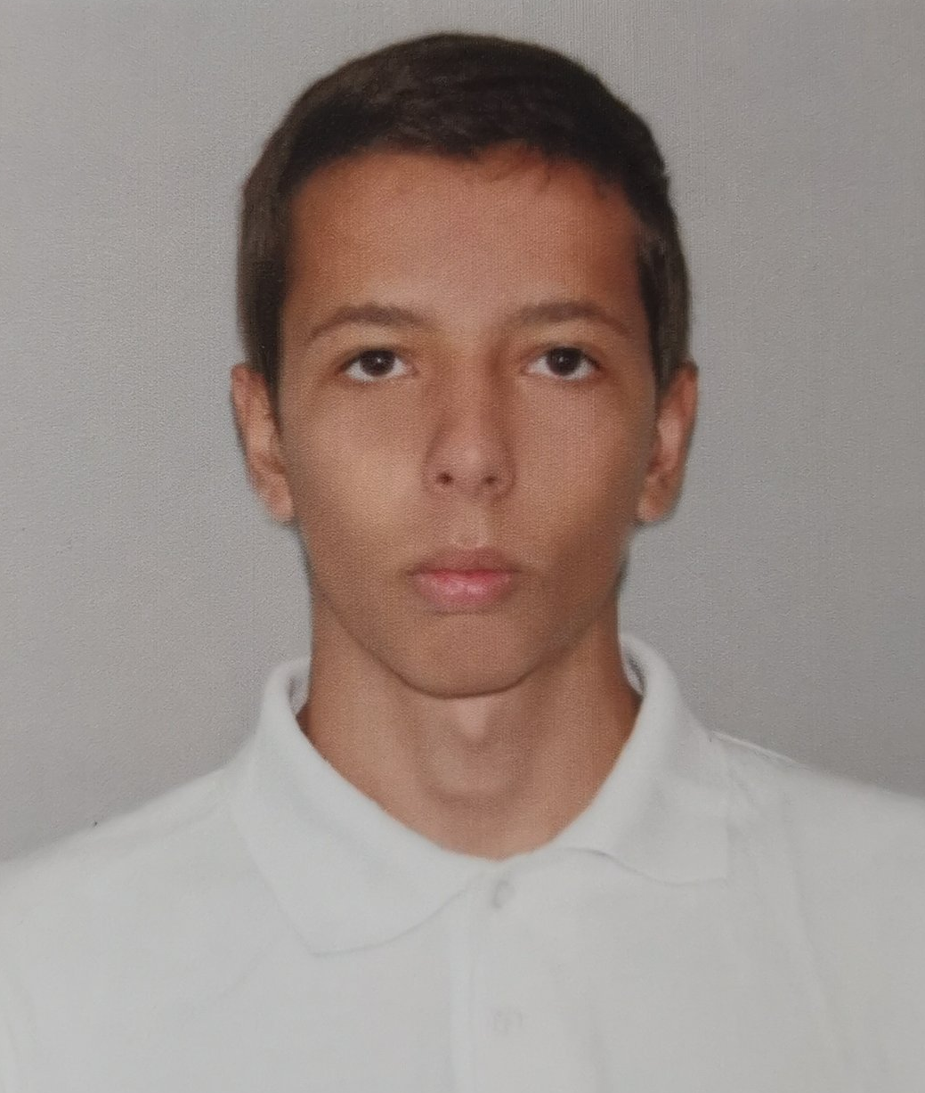
Our team
Иван Димов 10В
Кевин Русев 10Г
Теодора Лозева 10А
Станислав Дженевиз 10Б
Backend
Backend
Frontend
Scrum trainer

Slide 6










Technologies used

Slide 7
Lets move on to our project!

